Slide 1
PYTHON PROGRAMMING & DATA SCIENCE

Slide 2

Patterns and Features
In statistical machine learning, pattern recognition and data mining, data is represented as a pattern matrix or data matrix.
The rows of the data matrix correspond to patterns in the collection.
A pattern is also called point, vector, and sample in pattern recognition.
columns of the data matrix correspond to features.
A feature is a property or characteristic of a pattern.

Slide 3
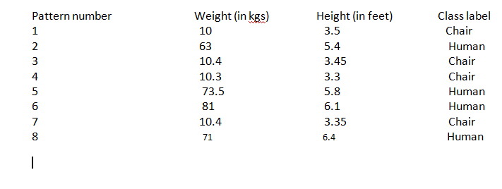
Patterns and Features
Example:
There are eight patterns which are represented using height in feet and weight in Kilograms.
There are two classes labeled chair and human corresponding to a possible collection of chairs and humans.

Slide 4
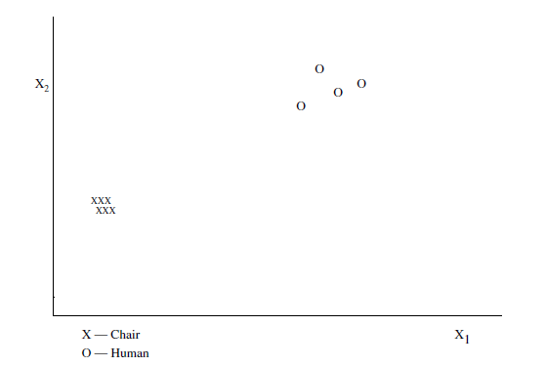
Patterns and Features
Weight and height are the two different features characterizing the chairs and humans in the collection and class label is the dependent feature that provides the semantic labels of the objects considered in table.
Each pattern is represented as a point in the two-dimensional space as follows.
In the graph where weight is the X1 feature and height is the second X2 feature.

Slide 5
Patterns and Features
A pattern is described by a collection of feature values.
Each feature is assigned a number or a symbol(Strings) as its value.
Types of Features
There are different types of features or variables. We may categorize them as follows:
1. Nominal variable
2. Ordinal variable
3. Interval variable
4. Ratio variable
5. Temporal data

Slide 6
Patterns and Features
1. Nominal variable:
The simplest variable where the domain has distinct values.
2. Ordinal variable:
The domain of this variable is an ordered set; so, the values are ordered.
3. Interval variable:
The domain is an ordered set where the differences between values have a meaningful interpretation.
4. Ratio variable:
The domain is similar to that of the interval variable where not only differences, but ratios are also meaningful.
5. Temporal data :
data which varies with time and spatial data.

Slide 7
Patterns and Features
1. Nominal data
A nominal feature fN assumes values from a set, that is the domain of fN denoted by D(fN). So, distinct objects can have different values that are drawn from the set D(fN). Here, different elements of D(fN) are distinct and they are not ordered as D(fN) is a set.
Some examples of nominal features are:
Type of Curve: A possible domain of this feature is
{line, parabola, circle, ellipse}.
2. Type of Publication: The domain of this variable will include
technical report, journal paper, conference paper, and book.
3. TV Manufacturer: The domain of this attribute could be
{Sony, Philips, Samsung, LG, Videocon, Onida}.

Slide 8
Patterns and Features
1. Nominal data
It is possible that a nominal variable is either binary or non-binary.
A binary feature has a domain with two elements.
Some examples of binary nominal variables are:
Gender : domain = {male, female}.
Beverage available: domain = {tea, coffee}.
The most popular application area where nominal data is routinely
encountered is information retrieval.
A document is typically viewed as a bag of words; so, it is a multiset without any ordering on the values or elements of the set.

Slide 9
Patterns and Features
1. Nominal data
Example 1.
Let us consider the following two documents.
• D1: The good old teacher teaches several courses
• D2: In the big old college
We represent the documents as multisets given by:
R1 = {The, good, old, teacher, teaches, several, courses} and
R2 = {In, the, big, old, college},
where R1 and R2 are representations of the documents D1 and D2 respectively.

Slide 10
Patterns and Features
Nominal data
several simple operations are performed to reduce the total number of terms.
For example,
converting uppercase characters to lowercase gives us the following representations:
R1 = {the, good, old, teacher, teaches, several, courses} and
R2 = {in, the, big, old, college}.
2. By stemming, that is by transforming the words to their stemmed forms, we can replace “teacher” and “teaches” by “teach” and “courses” by “course” to get
R1 = {the, good, old, teach, teach, several, course} and
R2 = {in, the, big, old, college}.

Slide 11
Patterns and Features
Nominal data
For example,
3. It is possible to represent a collection of documents by the union of their multisets.
R = {(the, 2), (good, 1), (old, 2), (teach, 2), (several, 1), (course, 1), (in, 2),
(big, 1), (college, 1)}
It is possible to view each document also as a histogram of term frequency values.
For example, the histograms corresponding to documents D1 and D2, after case folding and stemming are given by

Slide 12
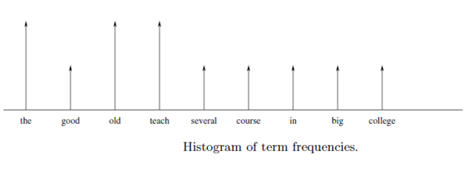
Patterns and Features
Nominal data
For example,
Histogram(D1): {(the, 1), (good, 1), (old, 1), (teach, 2), (several, 1), (course, 1)}.
Histogram(D2): {(in, 1), (the, 1), (big, 1), (old, 1), (college, 1)}.

Slide 13
Patterns and Features
Nominal data
Operations on nominal variables
Following 3 operations are applied on nominal variables. Those are:
comparison,
mode and
entropy
Example
Consider a dataset of 10 objects which are characterized by only one nominal variable. let the nominal variable be color.
The objects and their colors are given in the following set, where obji stands for object i.
{(obj1, blue), (obj2, blue), (obj3, red), (obj4, green), (obj5, blue),
(obj6, green), (obj7, blue), (obj8, red), (obj9, blue), (obj10, green)}

Slide 14
Patterns and Features
Nominal data
we can say that the domain of the nominal variable color is
Dcolor = {blue, red, green};
1. comparison:
example:
obj1 and obj2 are identical and are different from obj3.
In a similar manner we can compare any pair of objects in the set based
on the value assumed.
there are 5 blue, 3 green and 2 red objects in the collection, which means that the set can be represented by a histogram given by {(blue, 5), (red, 2), (green, 3)}.
Once we have the histogram, we can obtain the mode and entropy.

Slide 15
Patterns and Features
Mode:
Mode is the most frequent value of the variable.
In the example, we can observe from the histogram that blue has the highest frequency and so the mode is blue.
3. Entropy :
It is a function of the frequencies of values.
It characterizes in some sense impurity of the dataset;
if the variable assumes only one value in the whole dataset, then the dataset is pure and the entropy is zero.

Slide 16


Patterns and Features
Shannon’s entropy is the most popular characterization of entropy. It is given, for the dataset D by
where pi is the probability of value i and d is the size of the domain of the variable under consideration.
the values of probabilities obtained based on their frequencies of occurrence are:
For these probability values, the entropy is 0.4472.

Slide 17
Patterns and Features
2. Ordinal data
In the case of ordinal data, the elements of the domain of the variable are ordered, in addition to being distinct.
Some examples of ordinal features are:
Height of an object:
domain = {very tall, tall, medium, short, very short}.
Ranking of documents.
quality of a document based on a scale from 1–9; reviewers are asked to rank a paper submitted for possible publication.
3. Sentiment mined from a collection of documents (perhaps tweets) on a product:
domain = {very negative, negative, neutral, positive, very positive}.

Slide 18
Patterns and Features
2. Ordinal data
Operations possible on ordinal variables
As an ordinal variable has domain whose elements are distinct, all the operations on nominal variables are possible on ordinal variables also.
So, comparison, mode, and entropy are possible.
In addition, ordering among the values permits operations like median and percentile.
Median is the most centrally located value in the domain.
For example,
medium value of variable Height; neutral for variable sentiment; and value 5 for the variable ranking based on a scale from 1 to 9 may be viewed as the median values in each case.

Slide 19
Patterns and Features
2. Ordinal data
Operations possible on ordinal variables
Percentile makes sense when the values of the variable are ordered. Top ten percentile indicates the value below which 90% of the values are located.
It is possible to convert a nominal variable into an ordinal variable by
imposing some meaningful ordering.
Binary variables
In this method variable values are represented using binary digits. i.e 0 or 1.
For example,
consider D1 and D2.
There are nine distinct terms in these two documents. They are: big, college, course, good, in, old,several, teach, the in the lexicographically sorted order.

Slide 20
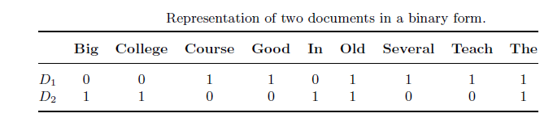
Patterns and Features
Using these nine terms, the two documents can be represented as binary strings as shown below
3. Interval-valued variables
For interval-valued variables, the differences between values are meaningful.
An example is: Temperature in Celcius and Fahrenheit:
10◦C is five degrees more than 5◦C

Slide 21
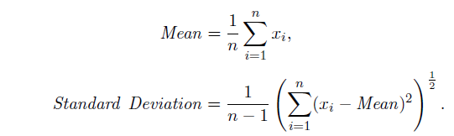
Patterns and Features
Interval-valued variables
Operations possible on interval-valued variables
Mean and Standard Deviation are two possible operations on these variables.
Example :
consider temperature over 5 consecutive days in summer in Bengaluru to be 35◦C, 36◦C, 36◦C, 37◦C, 36◦C.
Then the mean value is 36◦C and the variance is 0.4.
Another example of the interval-valued type is calender dates.

Slide 22
Patterns and Features
4. Ratio variables
A ratio variable, in addition to properties like distinctness, order, addition and subtraction, permits usage of multiplication and division.
Ratio variables are the most popular in Data Mining, Pattern Recognition, and Machine Learning.
Examples of ratio variables include weight and height of physical objects
5. Spatio-temporal data
There are several applications where the data is not static or fixed; it
is dynamic.
Dynamic data is routinely understood as time varying.

Slide 23
Patterns and Features
In dynamic datasets, we have the data to be one of the following:
Spatial Data:
Temporal Data:
Spatio-temporal Data:
Spatial Data:
In some applications, learning the predictive models is influenced by the spatial information of the data.
Example :
in predicting earthquakes, it is possible that for all other conditions
being equal, an area in some geographical location has a higher probability of being earthquake prone whereas some other area in a different geographical location may have a lower probability.

Slide 24
Patterns and Features
Temporal Data:
Data that varies with time is called temporal data.
Time series data is popular and here the successive time intervals are equally spaced or regular.
Examples:
Speech signal
web clicks;
Spatio-temporal Data:
In some applications, data varies both with space and time.
For example a search engine provides ranked results to a query. These results might change with time and also based on geographical location from which the user queried the search engine.

